Slide 1
Project 7: Parking Spaces Occupancy Prediction
Zoe Hite, Brian Aguilar, Tejas Shetty, Atul Balaji, Vihaan Ambre
CS4624: Multimedia & Hypertext Capstone
Notes:
Vihaan

Slide 2
Outline
Problem Recap | Breaking down the why of our project
Features | Requirements of the project
System Architecture | Design, workflow
Deliverables | ML Frontend
Challenges | Issues we faced this semester
Timeline/Future | Potential future updates
Acknowledgements/ References | Resources used for this project
Demo | Live demonstration!
Notes:
Vihaan

Slide 3
Problem Recap
Currently, Virginia Tech’s parking lot situation leads to the following:
Parking scarcity leads to drivers wasting considerable time
Drivers may make uninformed decisions based on static parking availability information
No real-time updates for parking lot availability
Our project aims to improve upon these key points
Notes:
Vihaan

Slide 4
Features
Machine Learning Model
Time Series Graph with time series casting
Login
Blacksburg Map
Filter System (Dropdown menu)
Nearest parking garage (travel time)
Shortest distance
Garage with the most available parking spots
Weighted Formula Recommendation
Notes:
Tejas

Slide 5






System Architecture
Python
Flask
To create and train the ML Model
Framework for Python and can easily build APIs
MySQL
Chosen for its scalability and high performance
React
Easy to use and will ensure an efficient and responsive UI
Express
Server to communicate and connect system
Notes:
Tejas

Slide 6
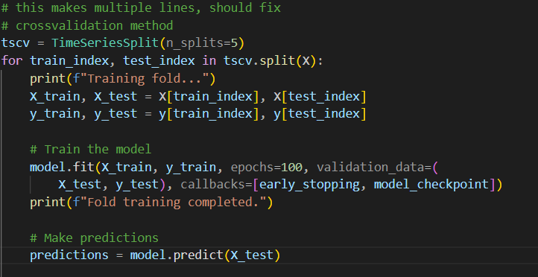
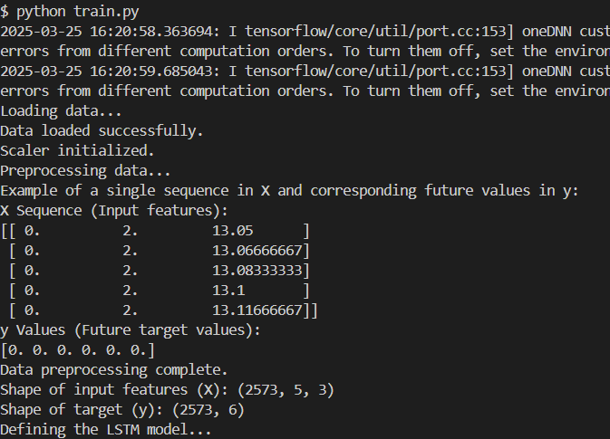
The ML Model
Time-based data extracted
Long Short-Term Memory (LSTM) a recurrent neural network process
Notes:
Zoe

Slide 7
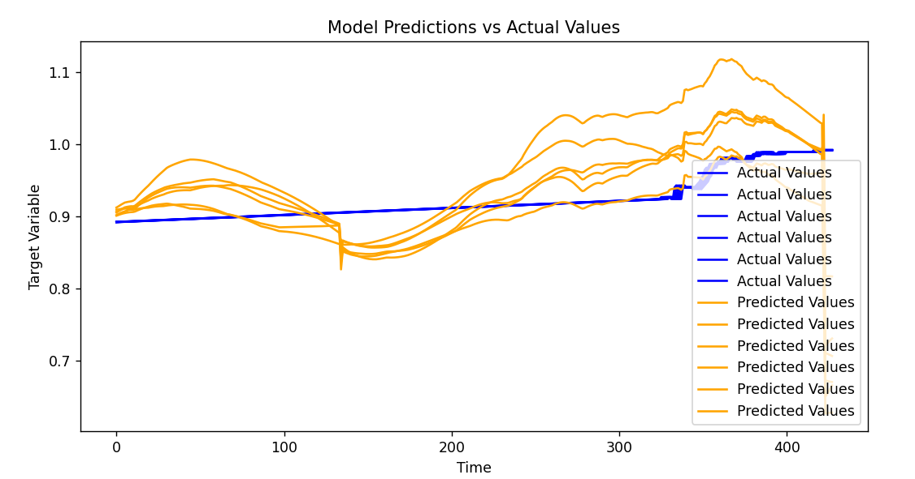
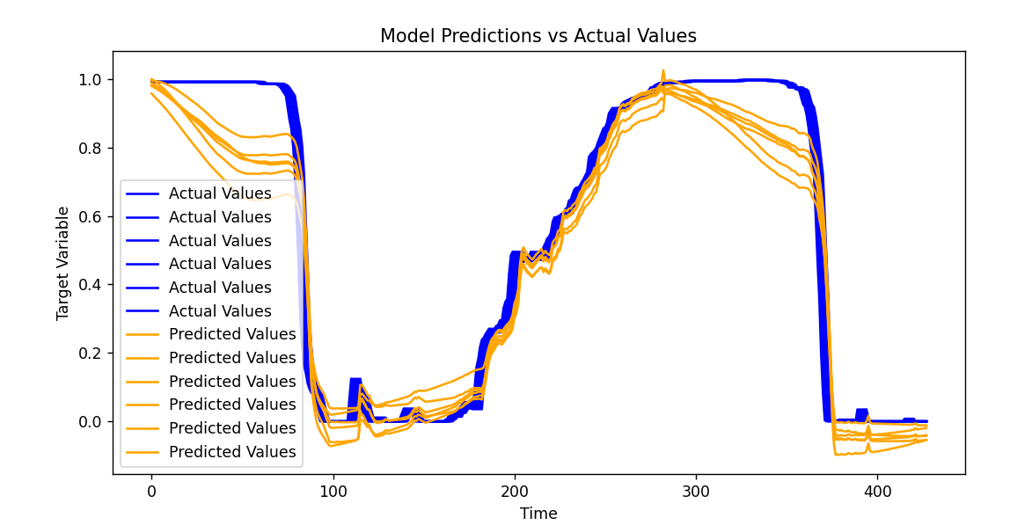
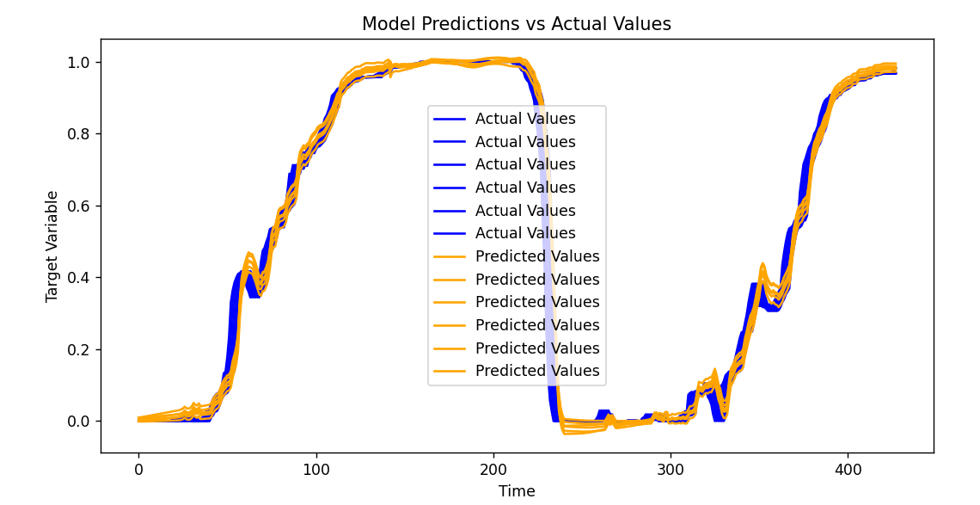
Training the data
Produce folds (iterations of training and testing)
Trained data is passed into backend
Notes:
Zoe

Slide 8
The Frontend
Redesign from old codebase
Modern design
More Hokie Themed
Improved UI/UX
Login/Profile Altered
User can save home address
User can manually input current location
Information of parking recommendation moved to sidebar
Notes:
Brian

Slide 9
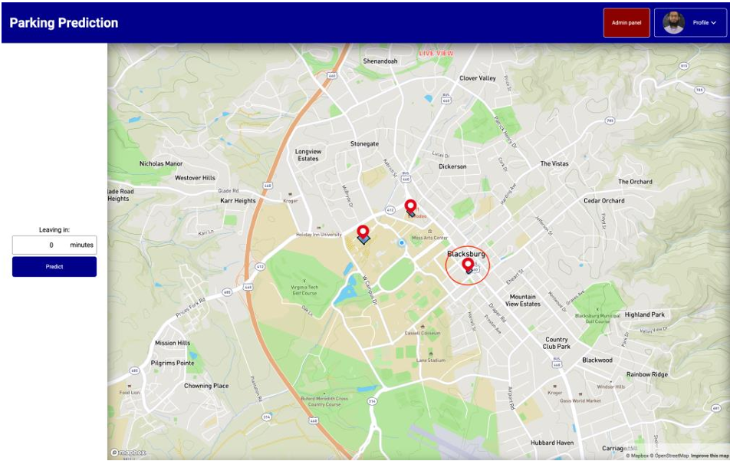
Previous Frontend
Notes:
Brian; Much more cleaner UI. The things that need to be refined are the drop down menu and maybe adding some admin tools such as viewing the data that is processed in live time. The current implementation hasn’t been linked to our backend as of yet.

Slide 10
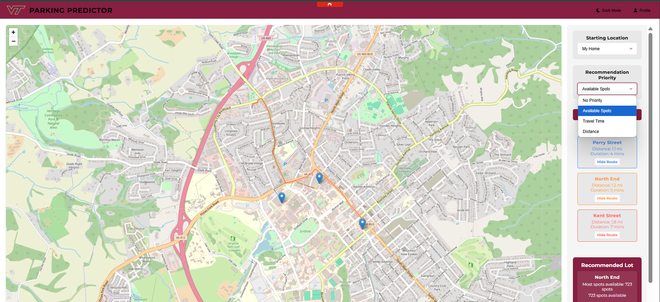
Current Frontend
Notes:
Brian

Slide 11
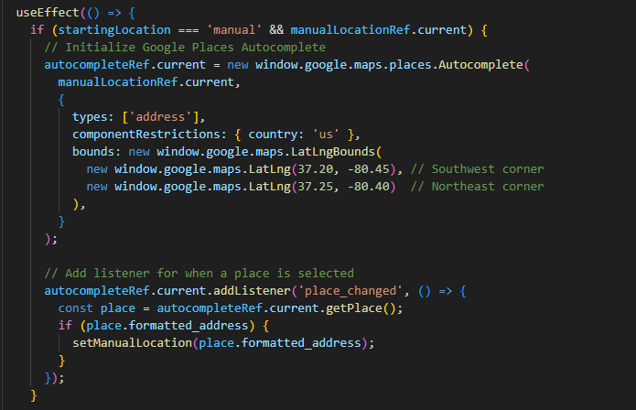
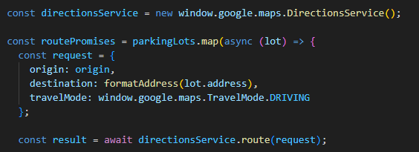


Use of Google Maps API
Places API
Directions API
Notes:
Brian: This code runs inside a useEffect hook and sets up Google Places Autocomplete when the user picks 'manual' as their starting location. It attaches autocomplete to a specific input field, only showing street addresses — no businesses or landmarks — and restricts results to the U.S. Plus, it focuses the autocomplete suggestions within a small, defined geographic area by setting a bounding box using latitude and longitude. This makes autocomplete faster, more accurate, and relevant to where we expect users to search. In this next block of code, we create a DirectionsService object from Google Maps to calculate driving routes. For each parking lot, we build a request with the user's starting location as the origin and the parking lot address as the destination. We then asynchronously call route() to get the driving directions for each lot.
Unfortunately, while google API makes these calls simple and mapping our locations efficient, it is free of use only for a certain amount of time. But it is plenty of time to test functionality and practical uses.

Slide 12
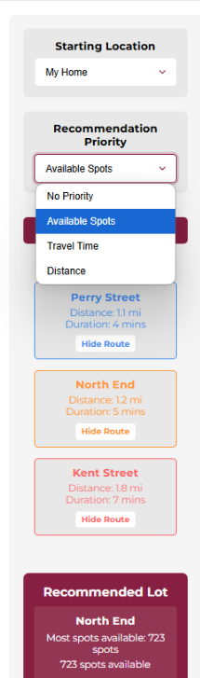
More on the Frontend
Displays necessary information once user searches
Distance
Travel Duration
Route
Hits backend endpoints to get number of parking spots available
Gets the backend ML models predictions and displays/calculates the best route for the given priority
Notes:
Brian

Slide 13
Challenges
Initial project setup was a hassle
Old frontend was non functional
Understanding the machine learning model
Working around our busy schedules
Notes:
Tejas

Slide 14
Past Timeline
1/28 - 2/3
2/4 - 2/10
2/11-2/18
2/19- 3/5
3/6-3/17
3/18-4/5
Milestone 1
Milestone 2
Milestone 3
Milestone 4
Milestone 5
Milestone 6
Review the Project Launch page, schedule an appointment with the Client, delegate tasks, and appoint a team leader
Identify potential datasets (contact Virginia Tech Parking Services), meet with client, establish novelties
Research previous projects, summarize findings, display information on project presentation, finalize timeline
Finalize dataset selection,
Begin initial ML model development (data preprocessing, feature selection)
Train a baseline ML model, evaluate initial results & refine approach
Debug the API to interact with the ML model, test API with sample requests, set up and integrate database for parking data storage
.
Presentation 2
Notes:
Atul

Slide 15
Timeline: Presentation 2 -> Now
4/6 - 4/10
4/11 - 4/17
4/18 - 4/24
4/25 - 5/2
Milestone 7
Milestone 8
Milestone 9
Milestone 10
Presentation 3
Develop UI wireframes/mockups,
build a working prototype with dummy data
Connect ML model, API, database, and frontend
Conduct unit and integration testing
Optimize model performance and database queries
Finalize user & developer manuals
Prepare final project demo
Notes:
Atul

Slide 16
Future Improvements
Live Location
Live Data
Acquires the location from where you’re using your device
Accurate, Blacksburg live data used for prediction
Notes:
Atul

Slide 17

Acknowledgements
Client
Mohamed Farag
mmagdy@vt.edu
Instructor
Dr. Farag
mmagdy@vt.edu
Notes:
Atul

Slide 18
References
James Jang, Nam Tran, Drew Loomis, Avi Mehta, Bowen Lin. (April 2023). Smart Parking Recommender Mobile Application. Report. Retrieved from Virginia Tech VTechWorks.
https://vtechworks.lib.vt.edu/items/3ad329e0-be66-4b62-b1d0-29646f88ba1f
Mohamed Farag, Josh Marcelin, Adi Hanumaiah, Antonio Lau, Kevin He, Eugene Kwon. (November 2023). Parking Spaces Occupancy Prediction. Report. Retrieved from Virginia Tech VTechWorks.
https://vtechworks.lib.vt.edu/items/d313d723-23ad-441d-9662-3bcc8cbed52c
Mohamed Farag, Amr Hilal, Samy El-Tawab. Parking Occupancy Prediction and Traffic Assignment in a University Environment. Report. Retrieved from professor.
Notes:
Atul

Slide 19
Final Demo
Notes:
Tejas

